Slide 1
The Role of Media in Bangladesh
Presented by
Mahmuda Khanom
Roll No: IS-02-06

Slide 2
Outlines
Media & Population
Informing the Public
Fostering Democracy and Political Participation
Influencing Public Opinion
Spreading Rumor
Impact on Youth

Slide 3
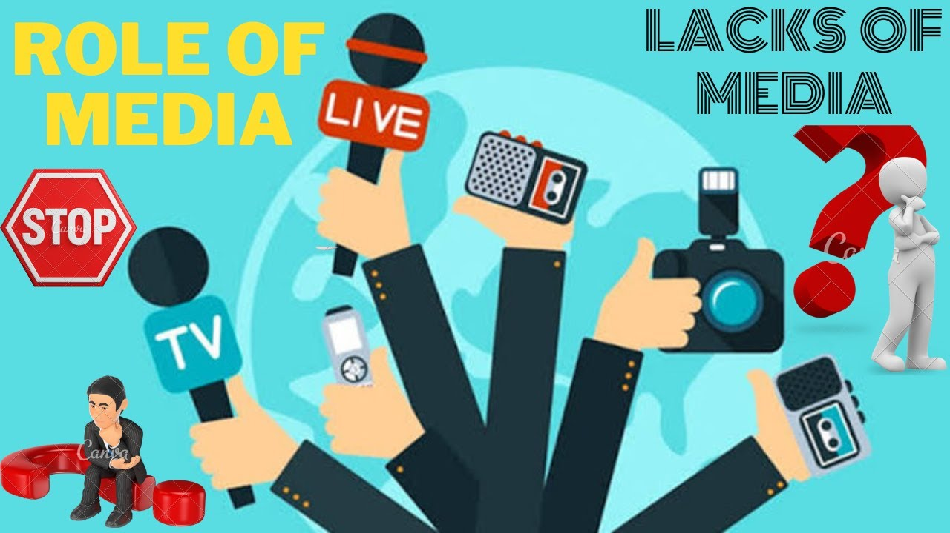
Media & Population
The July-August 2024 uprising in Bangladesh marked a pivotal moment, driven by youth demanding accountability and transparency. This movement called for a "Bangladesh 2.0," focused on good governance and systemic reform. Millions were inspired by the courage and determination of the youth, envisioning a new era for the country. A central expectation was for the media to play a vital role in supporting democracy

Slide 4

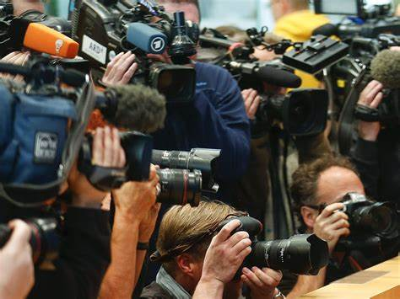
Informing the Public

Slide 5
"The media's the most powerful entity on earth. They have the power to make the innocent guilty and to make the guilty innocent, and that's power. Because they control the minds of the masses." — Malcolm X

Slide 6
Informing the Public
Real Information
Manipulation
Different sorts of media informs about news about politics,sports,job offers etc.
Inform about accidents,incidents,crimes.
Through ideologies media propagate power practice.
Manipulate people for buying products and sometimes deceived them.

Slide 7
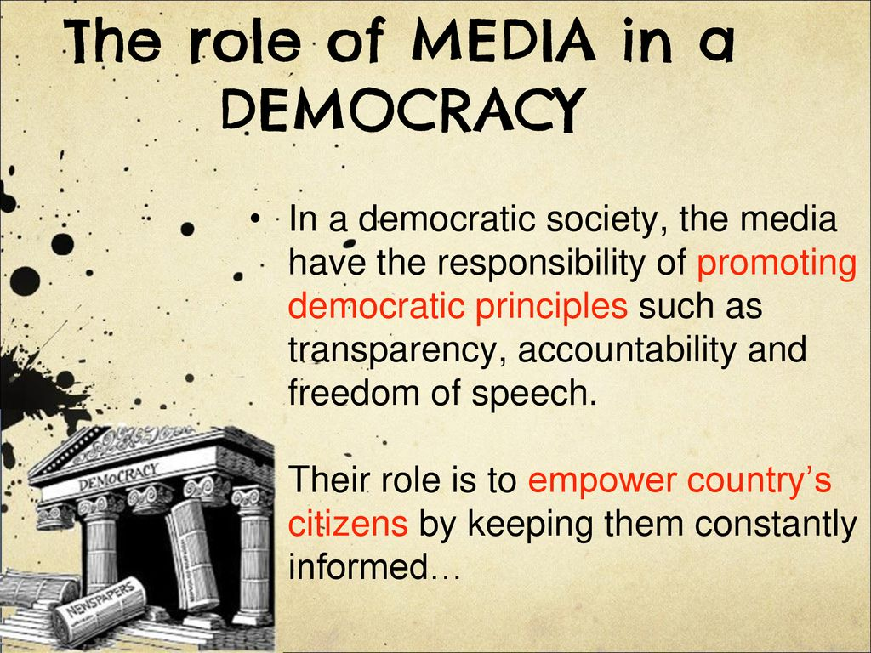
Fostering Democracy and Political Participation

Slide 8
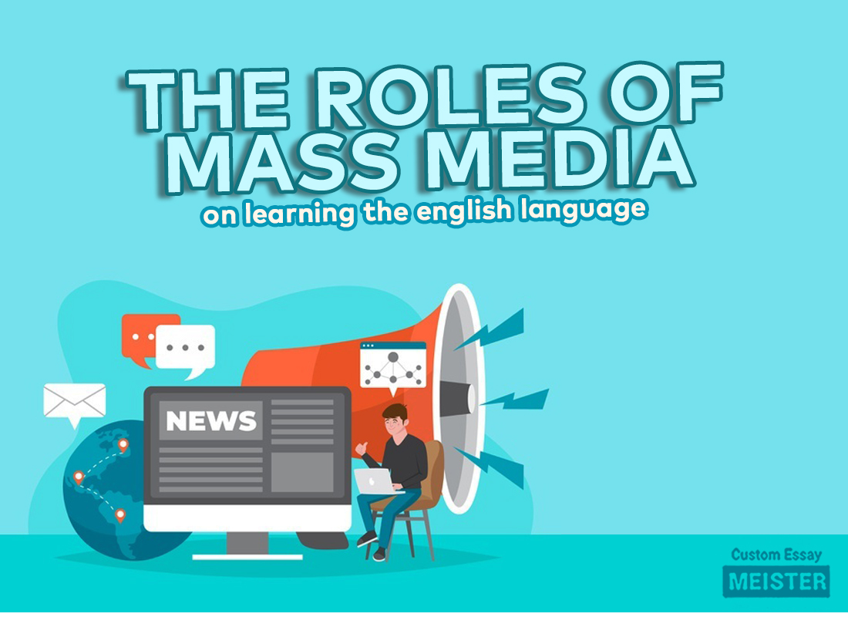
Influencing Public Opinion

Slide 9
Influencing Public Opinion
Age/Class | Impact
10-all ages | Emotionally
25->> | Politically
15->> | Economically
Women | Commodification
Youth | Psychologically

Slide 10
Critical Discussions
Media Criticism
Media criticism is the analysis and evaluation of media content, focusing on how information is presented and the impact it has on audiences. This field examines the biases, ethical considerations, and power dynamics within media industries to encourage informed media consumption and better understanding of media's role in society. By critically assessing media outputs, students and professionals aim to improve media literacy and promote more democratic and accurate information dissemination.Role of Media.pptx

Slide 11
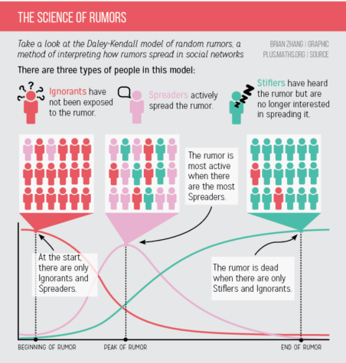
Spreading Rumor
Media?

Slide 12
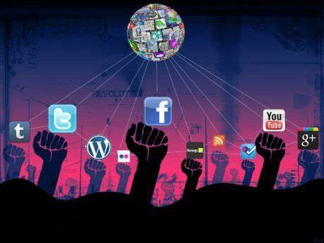
Impact on Youth

Slide 13
Social media has a profound impact on youth, influencing various aspects of their lives, both positively and negatively. Here are some key roles it plays:
Positive Impacts
Connection and Communication: Social media allows young people to stay connected with friends and family, regardless of distance.
Educational Resource: Platforms like YouTube, LinkedIn, and even Instagram offer educational content that can supplement traditional learning.

Slide 14
Let's delve into the negative aspects of social media on youth:
Mental Health Concerns
Anxiety and Depression: The constant comparison to others’ seemingly perfect lives can lead to feelings of inadequacy, anxiety, and depression.
Sleep Disruption: Late-night social media use can disrupt sleep patterns, leading to fatigue and decreased focus in daily activities.

Slide 15

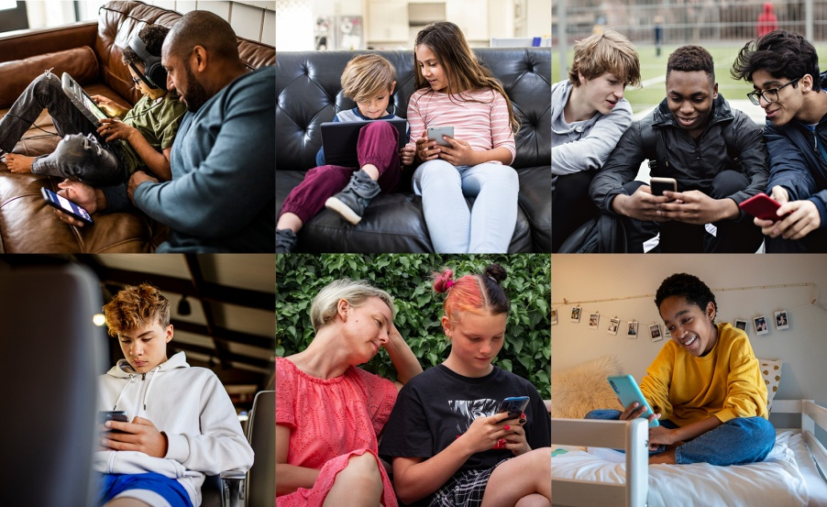
Differences in Leisure Time
Reading in Library
Spending hours on screen

Slide 16
Any Question?

